Slide 1



Techcruch Data Science Capstone Project
Early Detection of Diabetes using Health Indicators
Mobile Health Clinic Screening
Date
13th June, 2025
Team_Glucose_Guard

Slide 2


Introduction
•Diabetes is a growing health concern globally, often going undetected in early stages.
• Mobile health clinics aim to proactively screen and manage at-risk individuals to prevent complications.
•This project explores how basic health indicators can be used to develop a predictive model for early diabetes detection

Slide 3


Problem Statement
A mobile health clinic wants to pre-screen patients for diabetes using basic health indicators.
Goal: Use data science to identify patients at risk of diabetes using early indicators like BMI, glucose, insulin, and age.
Reduce hospital crowding and prioritize at-risk individuals.

Slide 4




Dataset Overview
Source: Pima Indians Diabetes Dataset (Kaggle)
Rows: 768 | Columns: 9
Features: Pregnancies, Glucose, BloodPressure, SkinThickness, Insulin, BMI, DiabetesPedigreeFunction, Age
Target: Outcome (0 = No Diabetes, 1 = Diabetes)

Slide 5

Exploratory Data Analysis (EDA)
Glucose and BMI show strong correlation with diabetes outcome
Most diabetic patients have higher insulin, glucose, and BMI values
Age and Diabetes Pedigree Function also impact risk

Slide 6
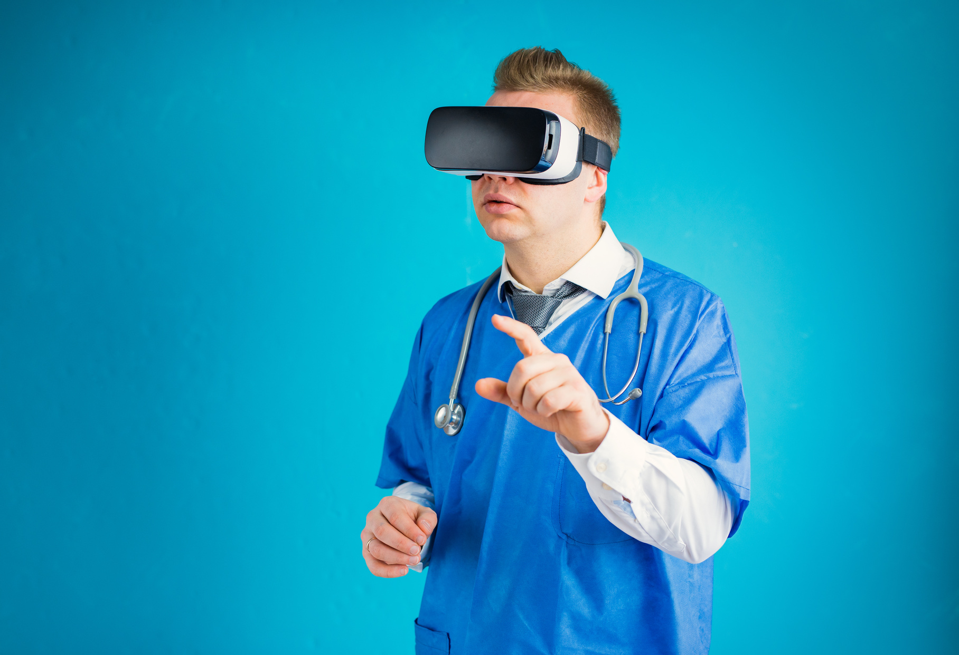

Data Preprocessing
Identified non-numeric values (e.g., 'Young') and handled them
Cleaned and standardized numeric features
Scaled data using StandardScaler
Split dataset: 80% training / 20% testing

Slide 7

Model Training & Evaluation
Trained classification model (e.g., Logistic Regression, Random Forest)
Evaluated using accuracy, precision, recall, F1-score
Good performance in predicting diabetes risk

Slide 8

Key Insights
Model can assist in triaging patients for further testing
High glucose and BMI are strong predictors of diabetes
Older individuals are more at risk

Slide 9
Use this model in mobile clinics to identify at-risk individuals early
Continuously improve with more data and real-time feedback
Consider integrating into a mobile app for health workers
Recommendations

Slide 10

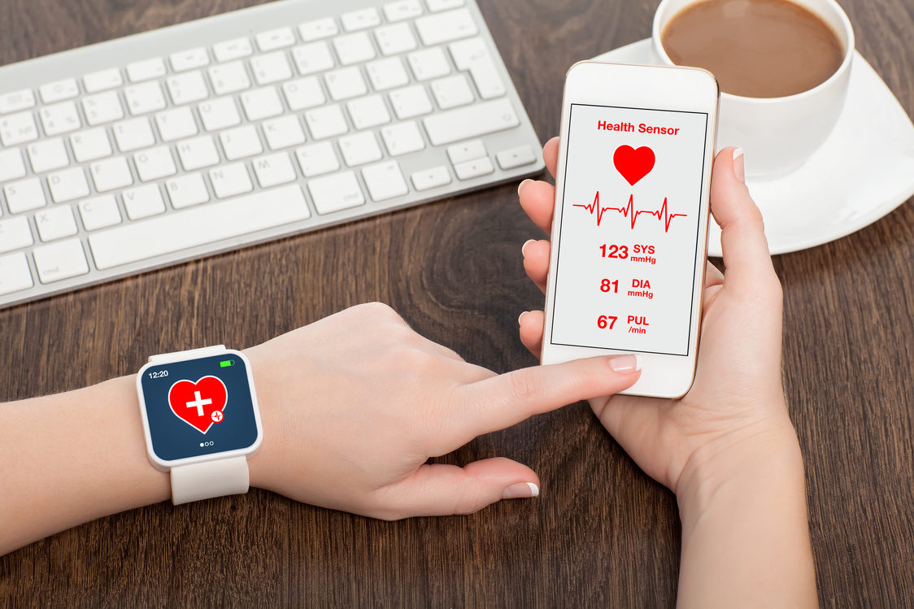
Further recommendation
Expand dataset with recent patient data
Develop user-friendly interface for real-time screening
Test additional models for improved accuracy
.

Slide 11

AI in Healthcare
Artificial Intelligence (AI) is transforming healthcare by enhancing decision-making and improving patient outcomes. By integrating AI technologies into various aspects of healthcare, such as diagnostics and treatment planning, providers can deliver more personalized care. AI assists in analyzing medical data, predicting health trends, and streamlining processes, ultimately making healthcare more efficient and effective for both patients and professionals.

Slide 12
Benefits of AI in Healthcare
Enhanced Patient Care
The integration of Artificial Intelligence (AI) in healthcare enhances patient care by providing accurate diagnostics and personalized treatment plans. AI systems analyze large datasets, enabling healthcare providers to make informed decisions tailored to individual patient needs.
Operational Efficiency
AI also improves operational efficiency by automating routine tasks and streamlining processes. This allows healthcare professionals to focus more on patient interactions and less on administrative duties, ultimately leading to better resource management and cost reduction.

Slide 13

Challenges in Health Tech
Despite the significant advancements in health technology, several challenges hinder its successful implementation and acceptance in the healthcare sector. These challenges include various factors that can impact effectiveness and trust:
Data Privacy Concerns
User Adoption
Protecting sensitive health information from breaches is crucial.
Resistance from patients and providers to adopt new technologies.
Integration Issues
Regulatory Compliance
Difficulty in integrating new tech with existing healthcare systems.
Navigating complex regulations surrounding health tech implementation.

Slide 14


Conclusion
In summary, health technology plays a vital role in enhancing wellness and improving healthcare delivery. The integration of digital tools, wearable devices, telemedicine, and AI empowers individuals to manage their health proactively. However, addressing challenges such as data privacy, integration, and user adoption is essential for maximizing the benefits of health tech. By working together, stakeholders can create a healthcare environment that embraces technology while ensuring patient safety and satisfaction.

Slide 15




Thynk Unlimited
Thank You
For your attention to this presentation.
reallygreatsite.com
123-456-7890
hello@reallygreatsite.com
123 Anywhere St., Any City

